Slide 1
Discrete Mathematics BCSC 0010
Module 2 Normal Forms

Slide 2
Normal forms
If the number of variables , involved in a given statement are more, then the construction of truth tables may not be practical, therefore, we consider other method known as reduction to normal form.
In this method, we use the word
“product” in place of “conjunction”
“sum” in place of “disjunction”

Slide 3
Some Basic terms Related to Normal Form
Elementary Product: A product of the variables and their negations is called an elementary product.
Eg: Let p and q be any two variables, then p, q, pΛq, ~ p Λ ~ q, p Λ ~q, ~p Λ q….. etc. are elementary products.
Elementary Sum: A Sum of the variables and their negations is called an elementary sum.
Eg: p, q, pVq, pV ~ q, ~ p V ~ q, ~pVq….. etc. are elementary sums.

Slide 4
Disjunctive Normal Form(DNF)
A statement which consists of a sum of elementary products of propositional variables and is equivalent to the given compound statement, is called a disjunctive normal form of the given statement.
This form is not unique for the given statement.

Slide 5
Conjunctive Normal Form(CNF)
A statement which consists of a product of elementary sums of propositional variables and is equivalent to the given compound statement, is called a Conjunctive normal form of the given statement.
This form is not unique for the given statement.

Slide 6
Minterms
Let p and q be two propositional variables.
All possible formulas which consist of product of p or its negation and product of q or its negation, but should not contain both the variable and its negation in any one of the formula are called minterms of p and q.
Eg: For two variables p and q, there are 2² = 4 minterms, namely,
pΛq, pΛ~q, ~pΛq, ~pΛ~q
If there are n variables then number of minterms = 2^{n}

Slide 7
Maxterms
Let p and q be two propositional variables.
All possible formulas which consist of sum of p or its negation and sum of q or its negation, but should not contain both the variable and its negation in any one of the formula are called maxterm of p and q.
Eg: For two variables p and q, there are 2² = 4 maxterms, namely,
pVq, pV~q, ~pVq, ~pV~q.
If there are n variables then number of maxterms = 2^{n}

Slide 8
Method to find PDNF
1. Construct truth table for the given formula.
2. Identify the rows in which the formula has true – as truth value.
3. Construct minterms from each such rows by taking
(i) the variable with true – as variable itself and
(ii) the variable with false – as negated variable.
4. Sum of these minterms will be the required PDNF.

Slide 9
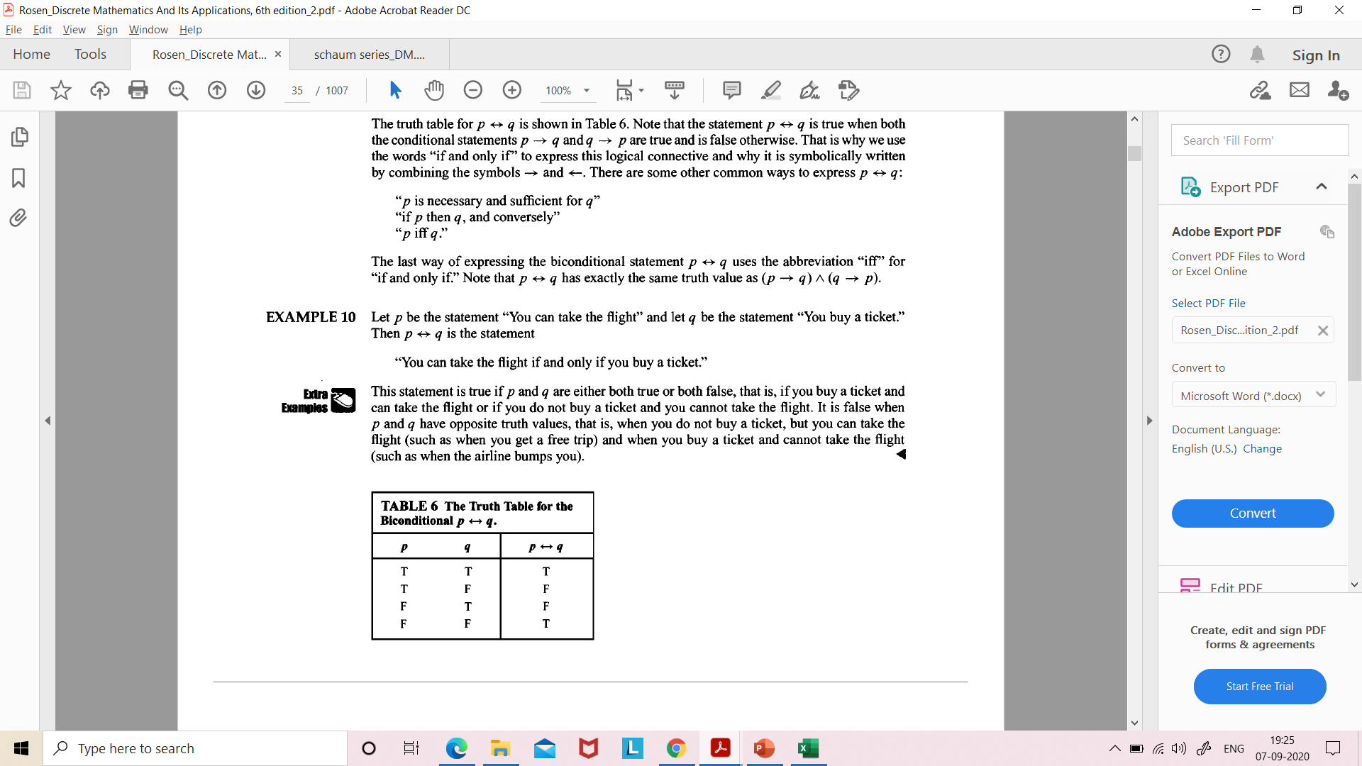
Example
PDNF for p→q will be (p^q)v(~p^q)v(~p^~q)
PDNF for p ↔q will be (p^q)v(~p^~q)

Slide 10
Obtain PDNF of (p^q)v(~p^r)v(q^r)
p | q | r | ~p | p^q | ~p^r | q^r | (p^q)v(~p^r) | (p^q)v(~p^r)v(q^r)
T | T | T | F | T | F | T | T | T
T | T | F | F | T | F | F | T | T
T | F | T | F | F | F | F | F | F
T | F | F | F | F | F | F | F | F
F | T | T | T | F | T | T | T | T
F | T | F | T | F | F | F | F | F
F | F | T | T | F | T | F | T | T
F | F | F | T | F | F | F | F | F
PDNF: (p ^q^r)v(p^q^~r)v(~p^q^r)v(~p^~q^r)

Slide 11
Method to find PCNF
1. Construct truth table for the given formula.
2. Identify the rows in which the formula has false – as truth value.
3. Construct maxterm from each such row by taking
(i) the variable with true -as negated variable and
(ii) the variable with false- as the variable itself.
4. Product of these maxterms will be the required PCNF.

Slide 12
Example
PCNF for p→q will be (~pvq)
PCNF for p ↔q will be (~p vq)^(p v ~q)

Slide 13
Obtain PCNF of (p^q)v(~p^r)v(q^r)
p | q | r | ~p | p^q | ~p^r | q^r | (p^q)v(~p^r) | (p^q)v(~p^r)v(q^r)
T | T | T | F | T | F | T | T | T
T | T | F | F | T | F | F | T | T
T | F | T | F | F | F | F | F | F
T | F | F | F | F | F | F | F | F
F | T | T | T | F | T | T | T | T
F | T | F | T | F | F | F | F | F
F | F | T | T | F | T | F | T | T
F | F | F | T | F | F | F | F | F
PCNF: (~pvqv~r)^(~pvqvr)^(pv~qvr)^(pvqvr)

Slide 14
Example
Obtain PCNF of (pvq)^~p→~q
Obtain CNF of ~(pvq) ↔ (p∧q)
Obtain DNF of ~(pvq) ↔ (p∧q)

